Slide 1
Biological Gene and Protein Networks and Their Place in Downstream Analysis
Why would we use networks?
bottom line up-front:
Prior biological knowledge greatly facilitates the meaningful interpretation of gene-expression data. Causal networks constructed from individual relationships curated from the literature are particularly suited for this task, since they create mechanistic hypotheses that explain the expression changes observed in datasets.
Notes:
Reference:
https://www.ncbi.nlm.nih.gov/pmc/articles/PMC3928520/pdf/btt703.pdf

Slide 2
Biological Networks
Gene regulatory network: two genes are connected if the expression of one gene modulates expression of another one by either activation or inhibition
Protein interaction network: proteins that are connected in physical interactions or metabolic and signaling pathways of the cell;
Metabolic network: metabolic products and substrates that participate in one reaction;

Slide 3
Background Knowledge
Cell reproduction, metabolism, and responses to the environment are all controlled by proteins;
Each gene is responsible for constructing a single protein;
Some genes manufacture proteins which control the rate at which other genes manufacture proteins (either promoting or suppressing);
Hence some genes regulate other genes (via the proteins they create) ;

Slide 4
What is Gene Regulatory Network?
Gene regulatory networks (GRNs) are the on-off switches of a cell operating at the gene level.
Two genes are connected if the expression of one gene modulates expression of another one by either activation or inhibition
An example.
Notes:
TRANSCRIPTION FACTOR: a protein that binds DNA at a specific promoter or enhancer region or site, where it regulates transcription. Transcription factors can be selectively activated or deactivated by other proteins, often as the final step in signal transduction. (from Wikipedia).

Slide 5
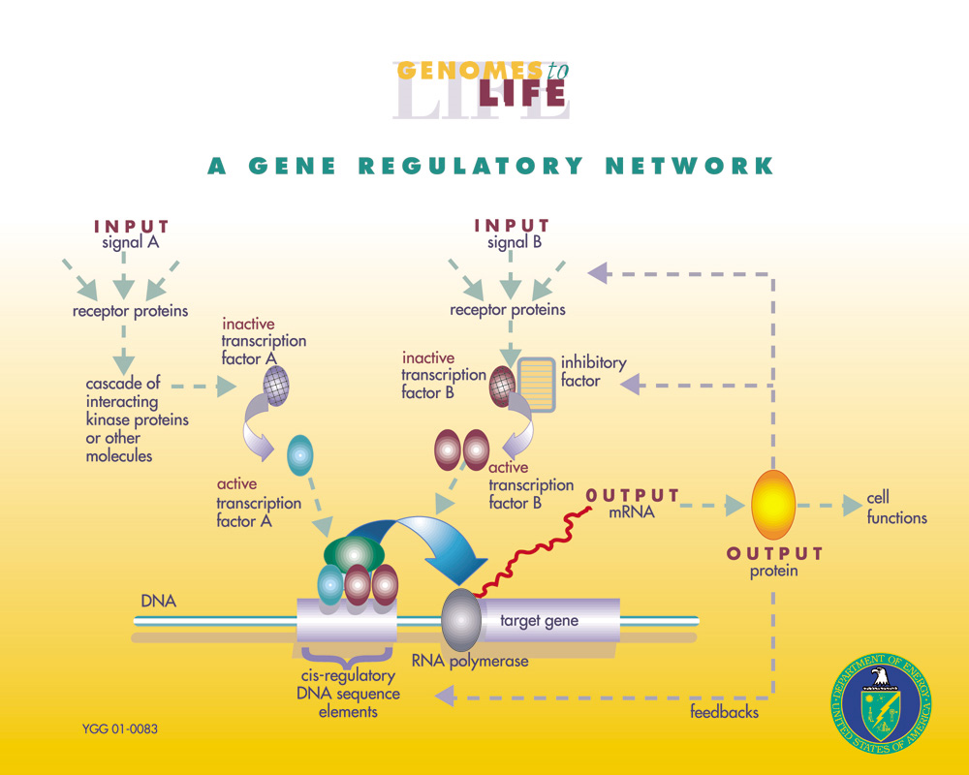
Sources: http://www.ornl.gov/sci/techresources/Human_Genome/graphics/slides/images/REGNET.jpg
Notes:
GRNs are remarkably diverse in their structure, but several basic properties are illustrated in this figure. In this example, two different signals impinge on a single target gene where the cis-regulatory elements provide for an integrated output in response to the two inputs. Signal molecule A triggers the conversion of inactive transcription factor A (green oval) into an active form that binds directly to the target gene's cis-regulatory sequence. The process for signal B is more complex. Signal B triggers the separation of inactive B (red oval) from an inhibitory factor (yellow rectangle). B is then free to form an active complex that binds to the active A transcription factor on the cis-regulatory sequence. The net output is expression of the target gene at a level determined by the action of factors A and B. In this way, cis-regulatory DNA sequences, together with the proteins that assemble on them, integrate information from multiple signaling inputs to produce an appropriately regulated readout.

Slide 6
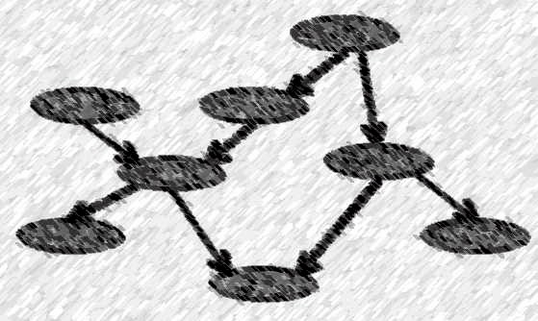
Simplified Representation of GRN
A gene regulatory network can be represented by a directed graph;
Node represents a gene;
Directed edge stands for the modulation (regulation) of one node by another:
e.g. arrow from gene X to gene Y means gene X affects expression of gene Y

Slide 7

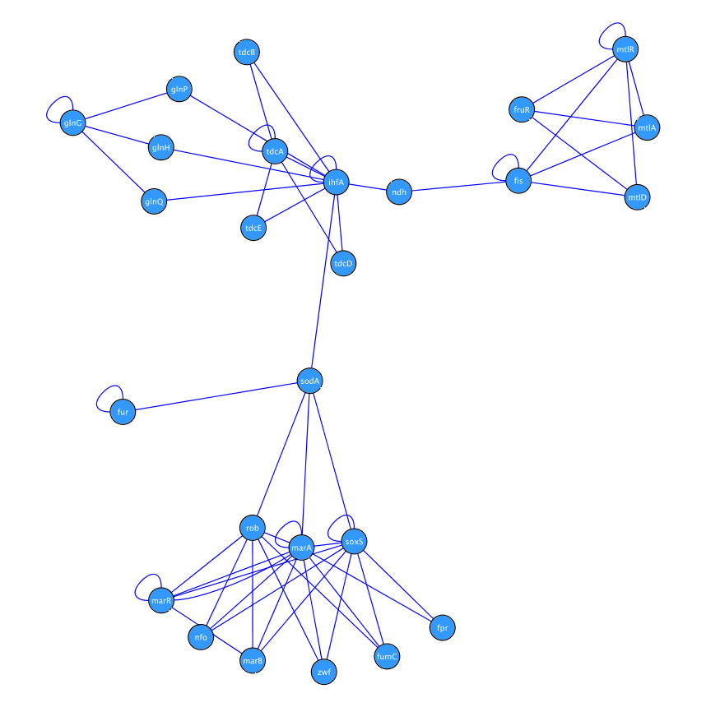
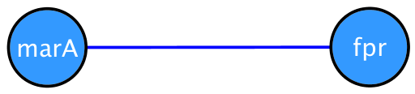
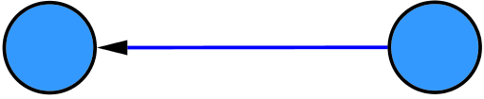
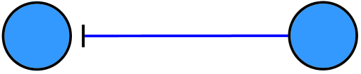
Directed vs. Undirected
Nodes
DNA / RNA / Protein / Metabolite / Ontology
Edges
Directed
Distinction between source and target
Activation (direct/indirect)
Repression (direct/indirect)
Undirected
No distinction between source and target
Co-expression (indirect)
Binding (direct)
Similarity/strength

Slide 8
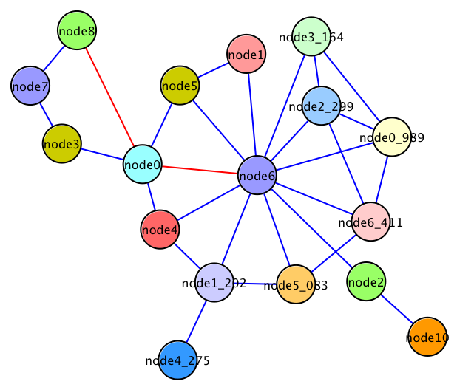
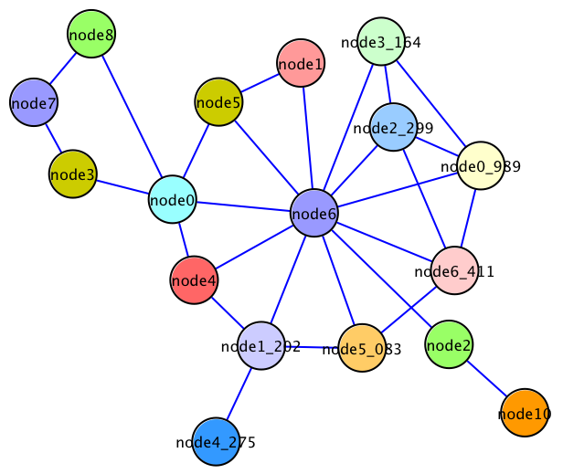
Basic Features
Degree
Number of connections that a node has
Distance
Number of connections between two nodes, in a shortest path
Path
A sequence of connections
Is there a path (reachability)
Mean Shortest Path distance (closeness)
In how many shortest paths (betweenness)

Slide 9
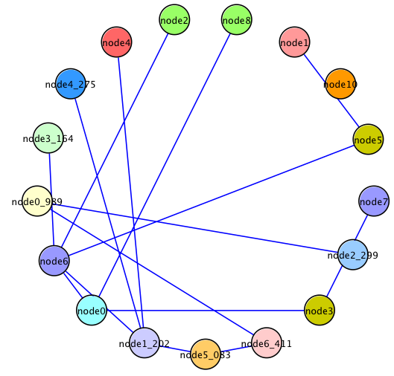
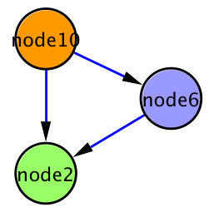
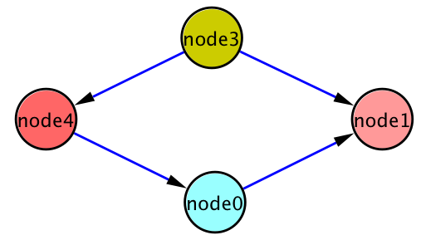
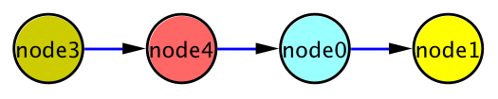
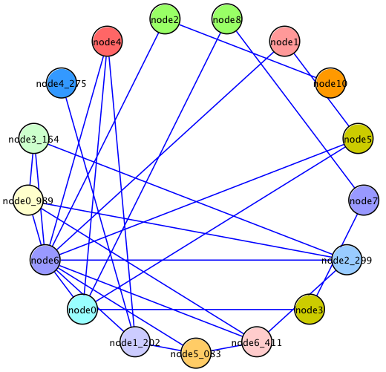
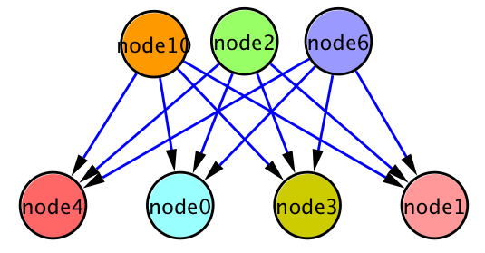
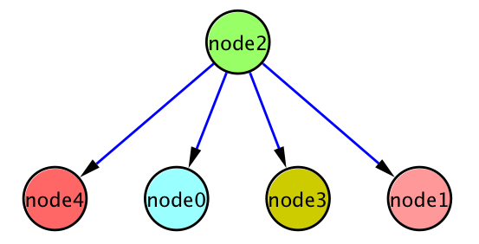
Basic Features
Size of a network (Number of nodes)
Density of a network (Proportion of the connections)
Motifs/Cliques/Clusters/Sub-networks
Loops
Parallels
Chains
Multi-input
Single input

Slide 10
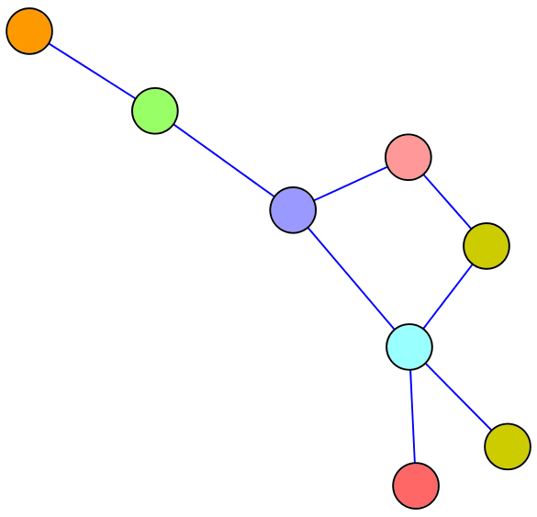
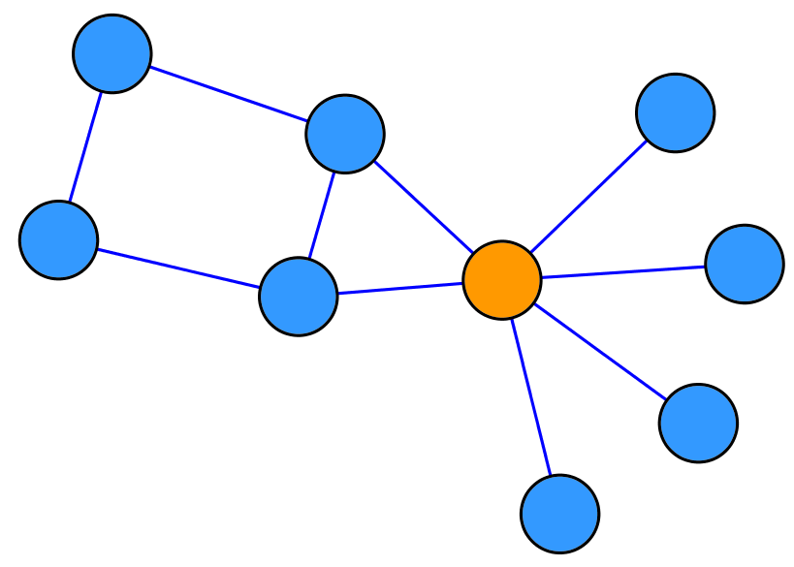
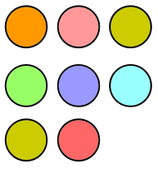

Basic Features
List of genes
Single gene
Regulators/Co-regulators
Upstream/Downstream elements in the network
Global connectivity/interconnectivity
Functional features
Differentially expressed subnetworks
One gene – one disease : bunch of genes – pathways
Nextgen sequencing data
Meta-analysis

Slide 11
Why Study GRN?
Genes are not independent;
They regulate each other and act collectively;
This collective behavior can be observed using microarray;
Some genes control the response of the cell to changes in the environment by regulating other genes;
Potential discovery of triggering mechanism and treatments for disease;

Slide 12
Modeling Gene Regulatory Networks
Linear Model;
Bayesian Networks;
Differential Equations;
Boolean Network
Originally introduced by Kauffman (1969)
Boolean network is a kind of Graph
G(V, F) – V is a set of nodes ( genes ) as x₁ , x₂, …, x_{n} F is a list of Boolean functions f(x₁ , x₂, …, x_{n})
Gene expression is quantized to only two level:
1 (On) and 0 (OFF);
Every function has the result value of each node;

Slide 13
Boolean Network Example
Nodes (genes)
Iteration
1
2
3
4
5
6
x1
0
1
X1
1
1
0
0
0
0
x2
0
1
X2
1
1
1
0
0
0
x3
0
1
X3
0
1
1
1
0
0
110
111
011
001
000
trajectory 1
100
010
101
trajectory 2
Start!
Source From Biosystems 20033443

Slide 14
Boolean Network as Models of Gene Regulatory Networks
cdk7
cdk2
Cyclin E and cdk2 work together to phosphorylate the Rb protein and inactivate it
Cdk2/Cyclin E is regulated by two switches:
Positive switch complex called CAK;
Negative switch P21/WAF1;
The CAK complex can be composed of two gene products:
Cyclin H;
Cdk7
When cyclin H and cdk7 are present, the complex can activate cdk2/cyclin E.
CAK
Rb
Cycin H
p21/WAF1
Cyclin E
DNA synthesis
cdk7
cdk2
cyclin H
cyclin E
Rb
p21/WAF1

Slide 15
Learning Causal Relationships
High-throughput genetic technologies empowers to study how genes interact with each other;
Learning gene causal relationship is important:
Turning on a gene can be achieved directly or through other genes, which have causal relationship with it.

Slide 16
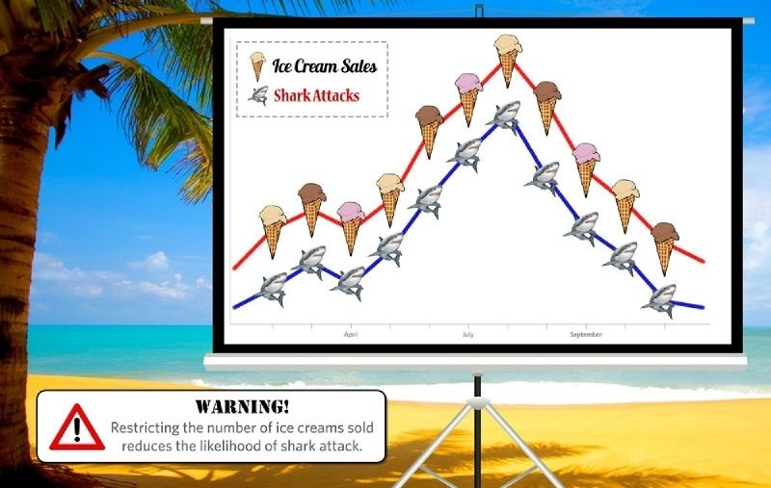
Clearing up Confusion Between Correlation and Causation

Slide 17
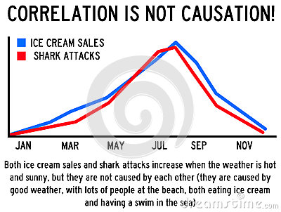

Slide 18
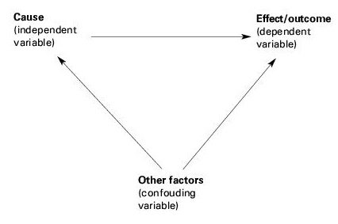
Prior knowledge greatly facilitates the meaningful interpretation of data.

Slide 19
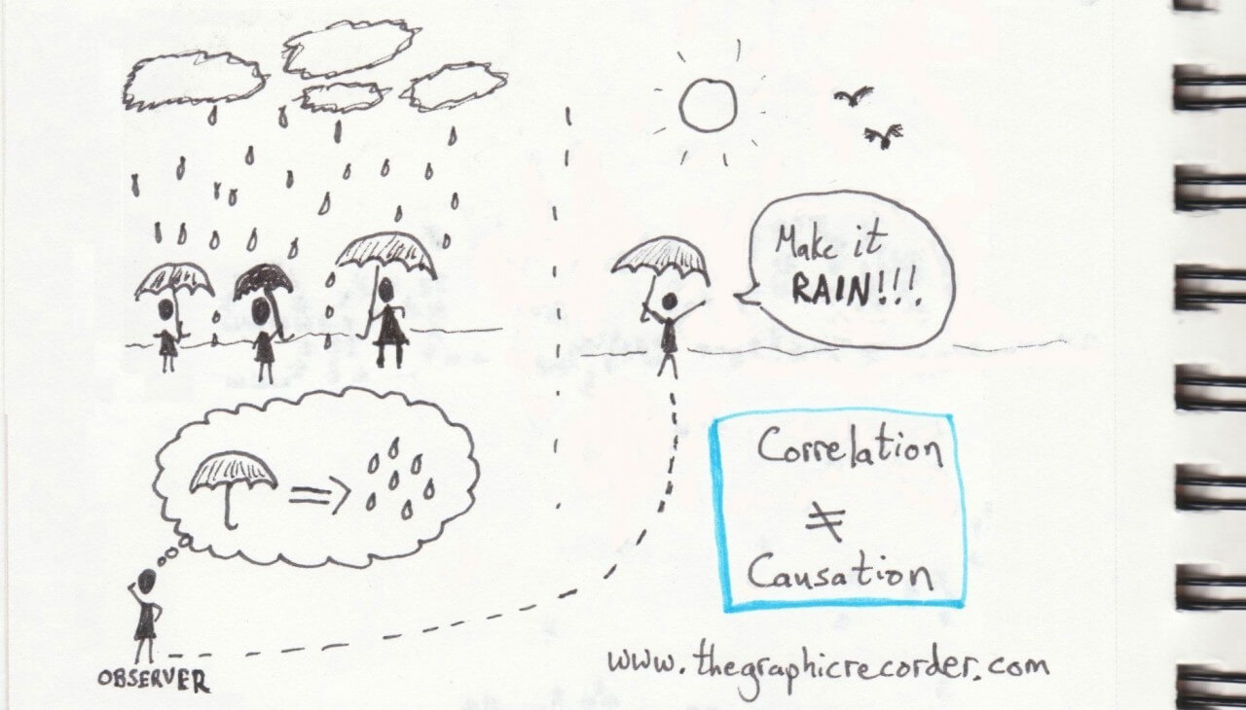
Upstream Regulator is the Weather, Downstream Effect is Increased Umbrella Use

Slide 20
Causality vs. Correlation
Example: rain and falling_barometer
Observed that they are either both true or both false, so they are related. Then write
rain = falling_barometer
Neither rain causes falling_barometer nor vice-versa.
Thus if one wanted rain to be true, one could not achieve it by somehow forcing falling_barometer to be true. This would have been possible if falling_barometer caused rain.
We say that the relationship between rain and falling_barometer is correlation, but not cause.

Slide 21
Learning Causal Relationship with Steady State Data
How to infer causal relationship?
In wet-labs, knocking down the possible subsets of a gene;
Use time series gene expression data;
Problem?
Human tissues gene expression data is only available in the steady state observation;
(IC) algorithm by Pearl et al to infer causal information but not in biological domain;

Slide 22
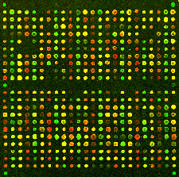
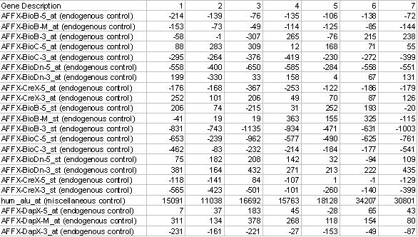
RNAseq Data Treated the Same as Microarray Data
Samples
Genes
Gene up-regulate, down-regulate;

Slide 23
How We Study Gene Causal Network?
We present an algorithm for learning causal relationship with knowledge of topological ordering information;
Studying conditional dependencies and independencies among variables;
Learning mutual information among genes;
Incorporating topological information;

Slide 24
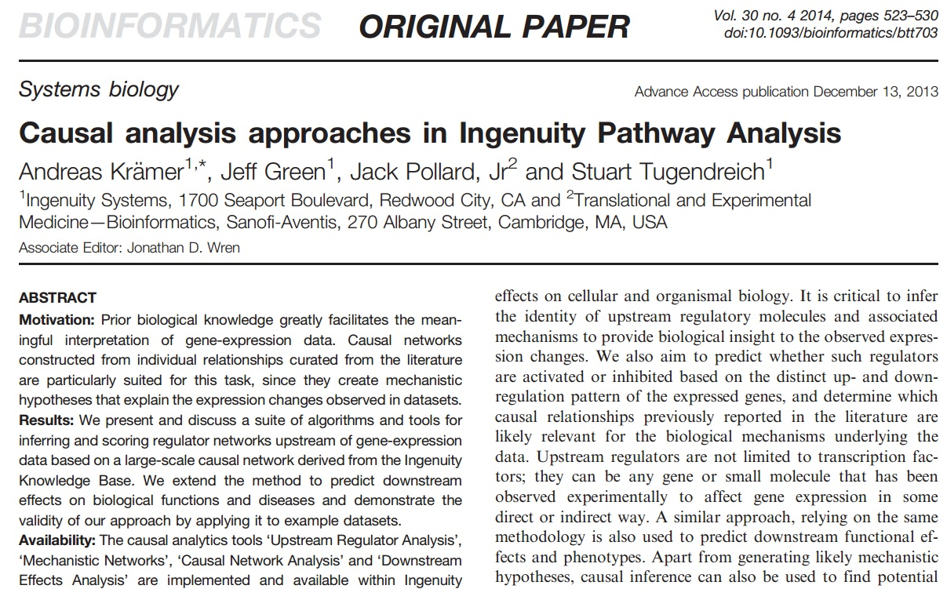
How we Study Gene Causal Network?

Slide 25
Learning from Multiple Data Sources
We have gene expression data and topological ordering information;
Incorporating some other data sources as prior knowledge for the learning;
Transcription factor binding location data;
…

Slide 26
Learning Causality in Motifs
Network motifs are the simplest units of network architecture.
They be used to assemble a transcriptional regulatory network.

Slide 27
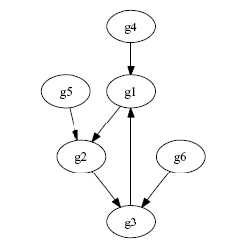
Learning GRN with Feedback Loops

Slide 28
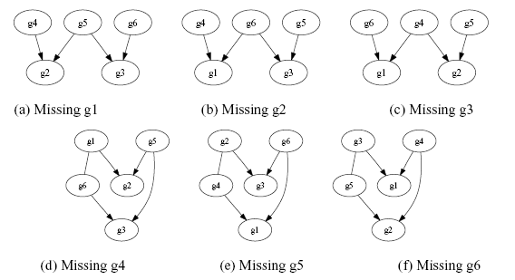
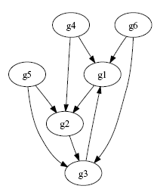
Learning GRN with Feedback Loops (Con’d)

Slide 29
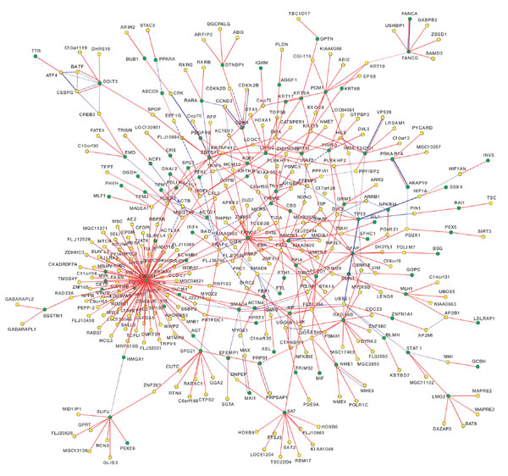
Protein-Protein Interactions
From:
Towards a proteome-scale map of the human protein–protein interaction network
Rual, Vidal et al. Nature 437, 1173-1178 (2005)

Slide 30
Why Study Protein-Protein Interactions
Most proteins perform functions by interacting with other proteins;
Broader view of how they work cooperatively in a cell;
Studies indicate that many diseases are related to subtle molecular events such as protein interactions;
Beneficial for the process of drug design.
Notes:
Finding interactions between proteins involved in common cellular functions is a way to get a broader view of how they work cooperatively in a cell.
Experimental studies indicate that many diseases are related to subtle molecular events such as protein interactions;
Inferring protein interactions, especially disease-related, beneficial for the process of drug design.

Slide 31
Reference Databases
Interactions
MIPS
DIP
YPD
Intact (EBI)
BIND/ Blueprint
GRID
MINT
Prediction server
Predictome (Boston U)
Plex (UTexas)
STRING (EMBL)
Protein complexes
MIPS
YPD

Slide 32
How to Study PPI?
High-throughput data
Two-hybrid systems
Mass Spectrometry
Microarrays
Genomic data
Phylogenetic profile
Rosetta Stone method
Gene neighboring
Gene clustering
Other Data Sources

Slide 33
Office of Cyber Infrastructure and Computational Biology
NGS : DOWNSTREAM PROCESSING

Slide 34
The Plan…
Downstream analysis
Gene sets
Transcriptome studies
Cistrome/Epigenome studies
Function enrichment
GSEA, DAVID, IPA
STRING, Cytoscape
Downstream processing
Genome coordinate sets
NGS alignment files (reads/tags)
ChIP-Seq peaks
BEDTools
Galaxy
UCSC Table browser

Slide 35
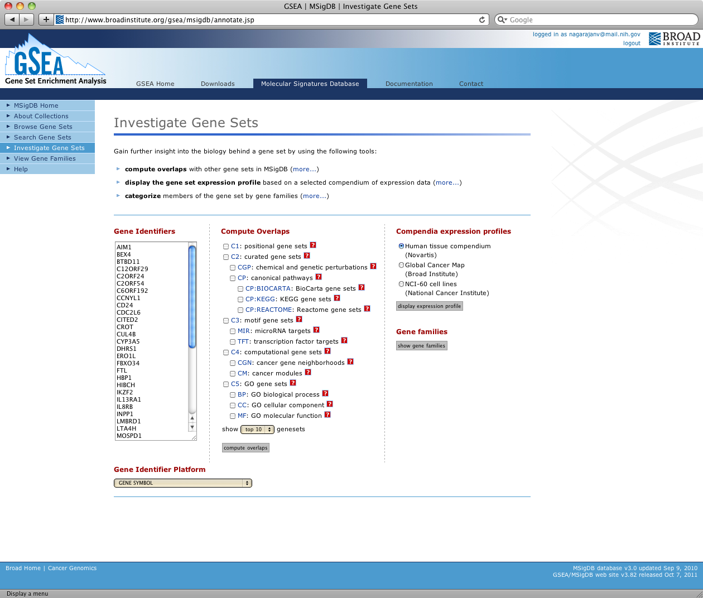

Slide 36
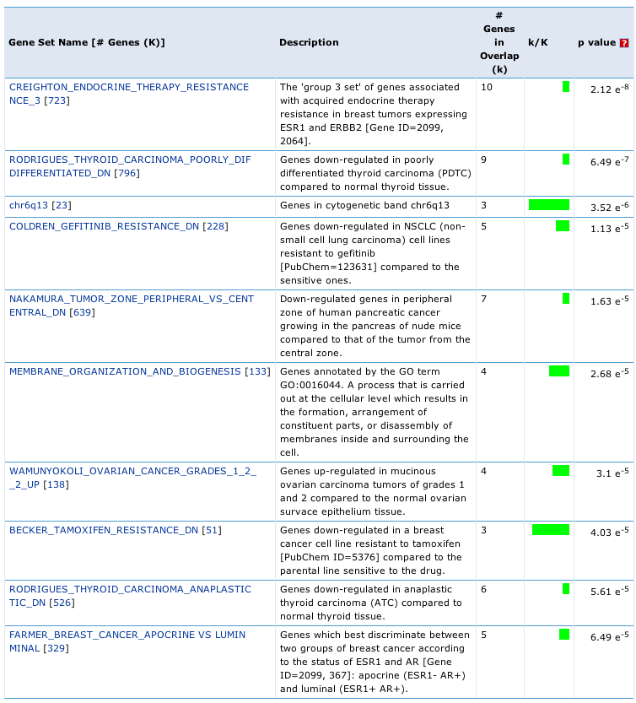
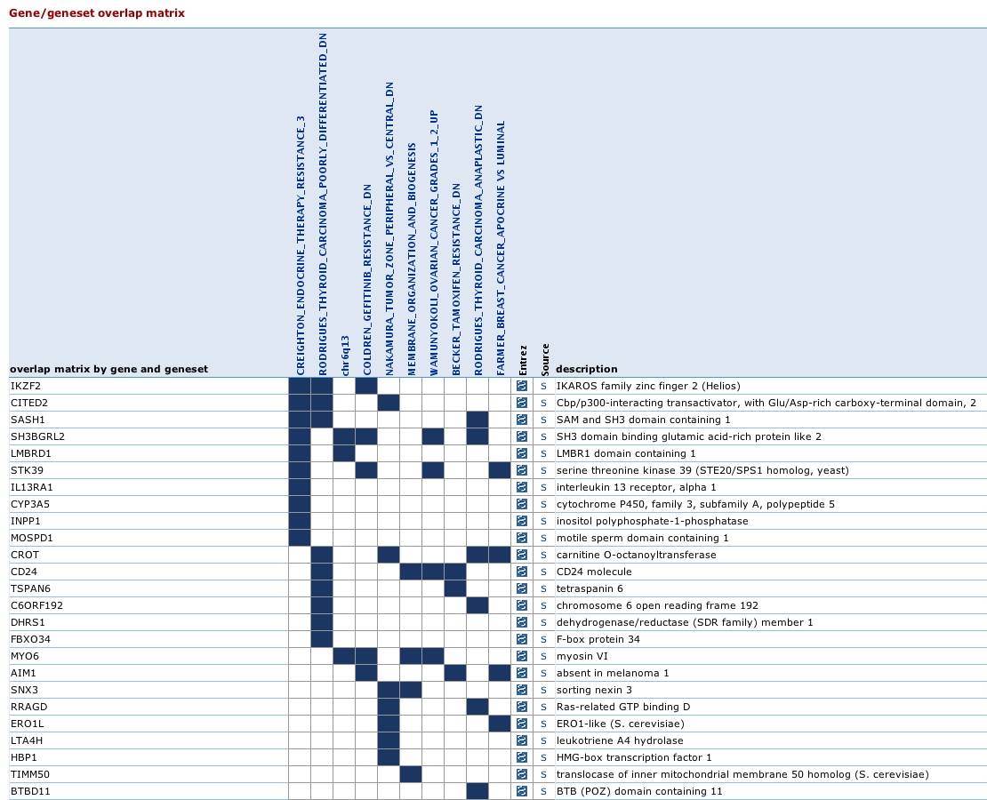
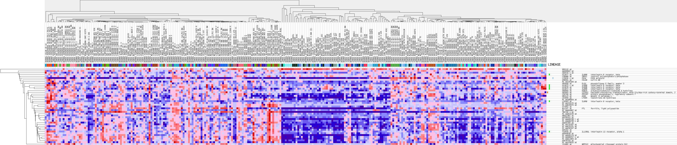
GSEA

Slide 37
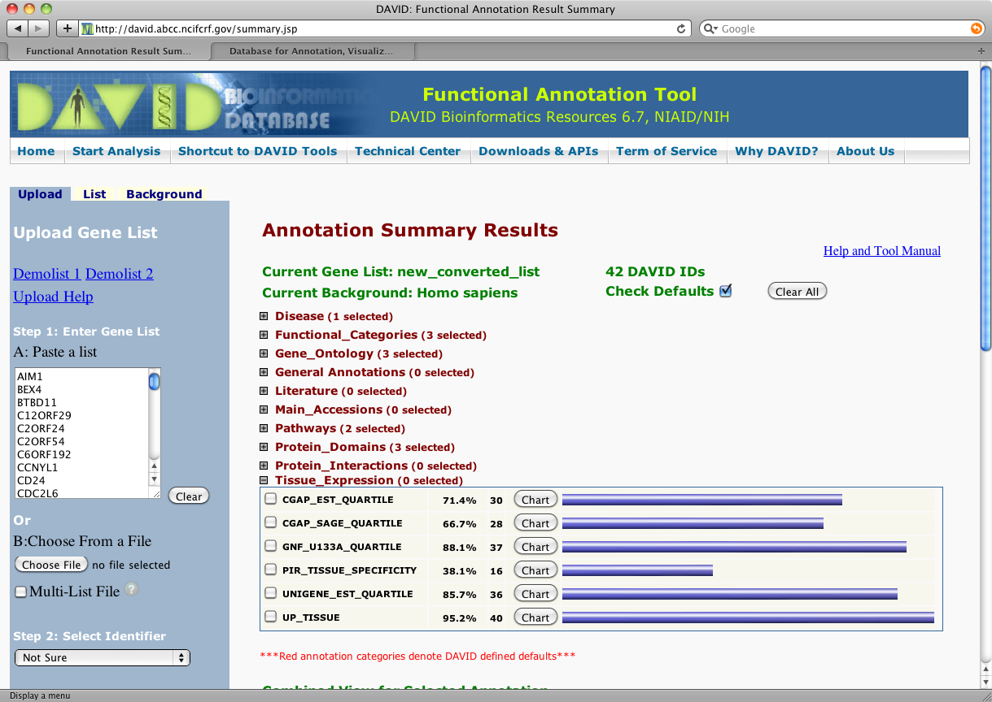
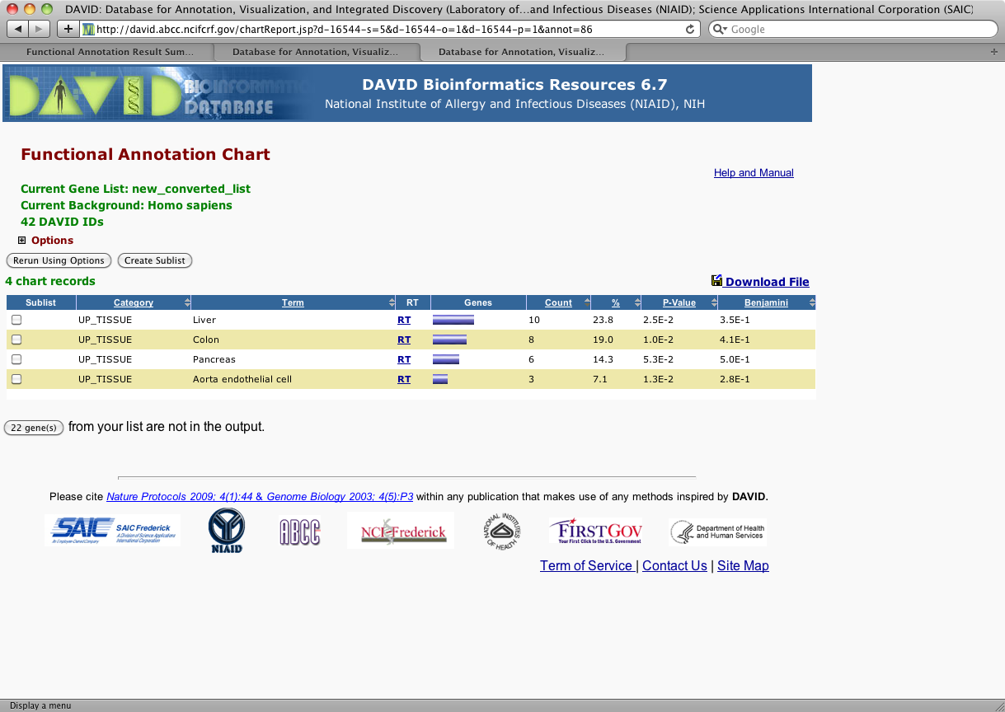
DAVID

Slide 38
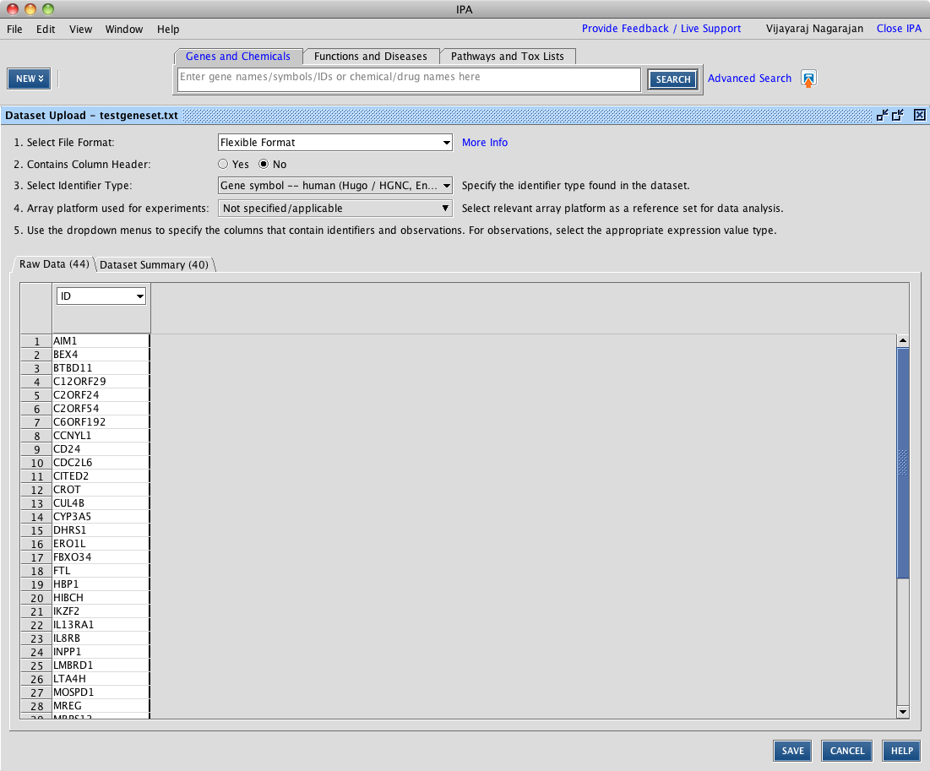
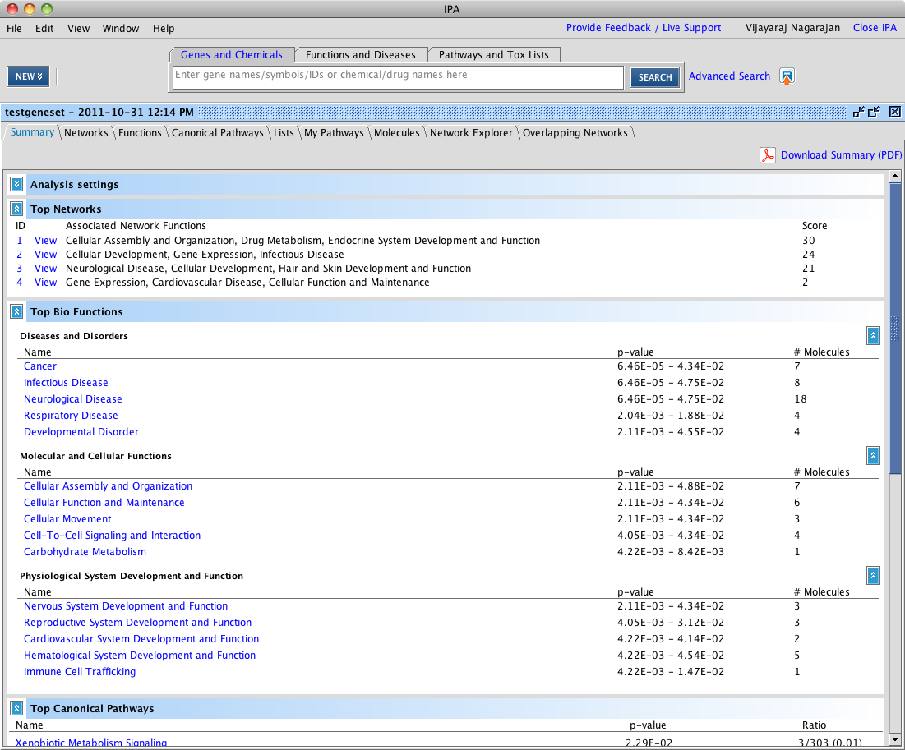
IPA

Slide 39
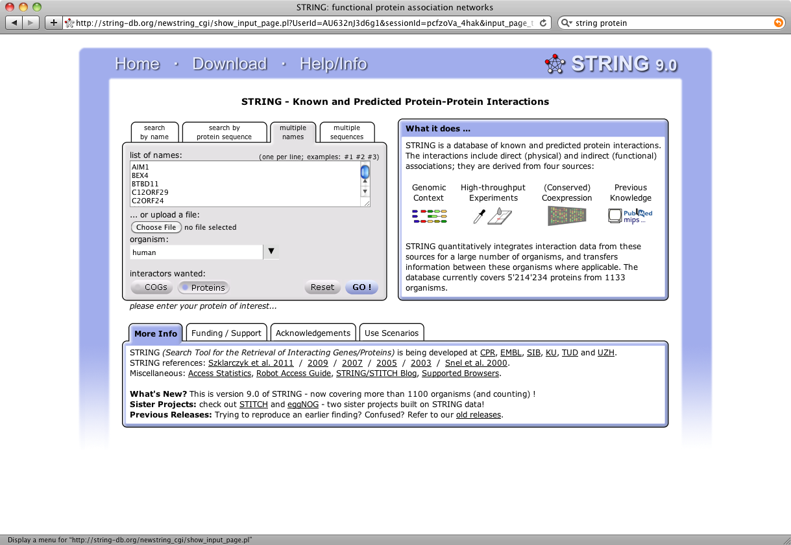
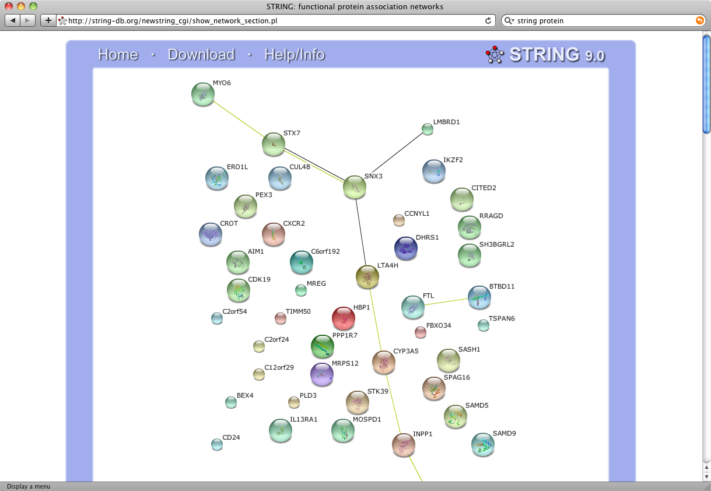
STRING

Slide 40
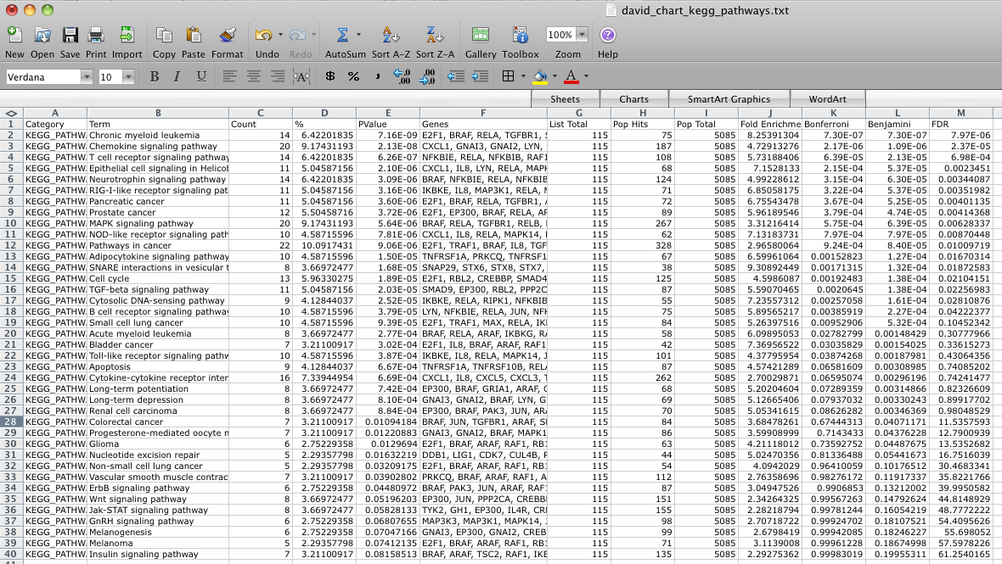
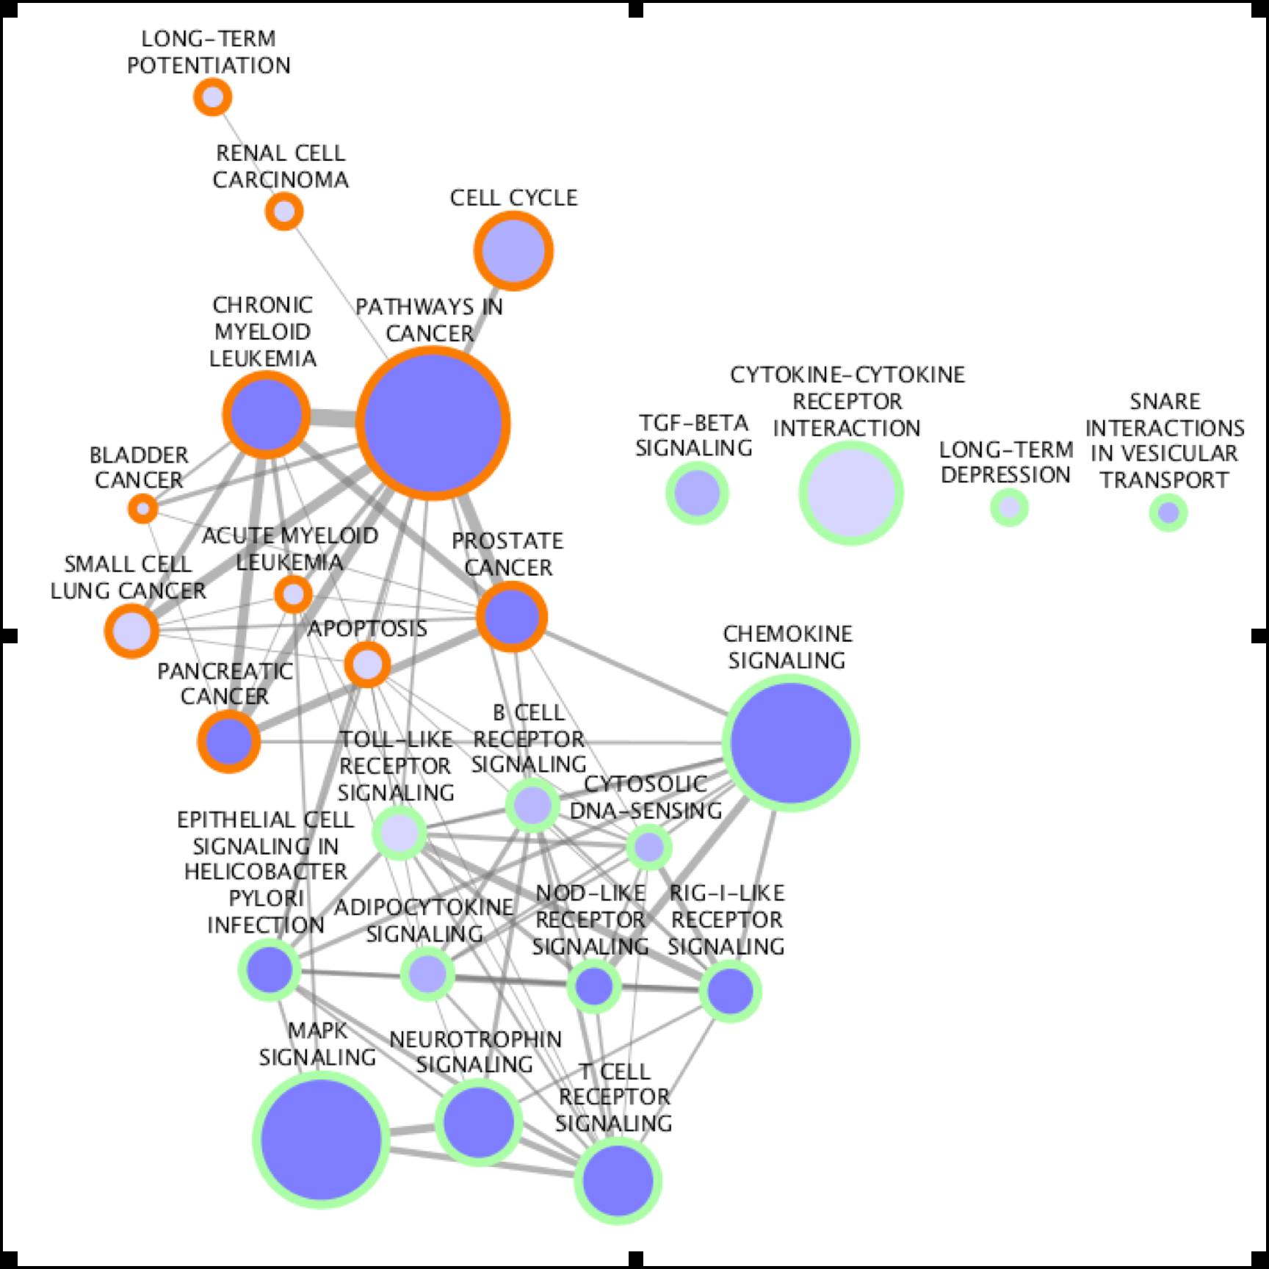
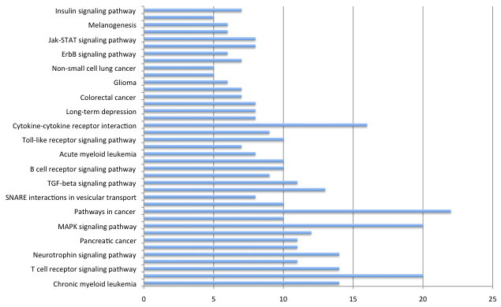
Cytoscape

Slide 41
BED-Tools
Command line
Open source
A variety of input formats (BED, BEDPE, SAM/BAM, GFF, VCF)
Things we could do…
Intersect, Union
Merge
Coverage
Subtract
Convert
Closest
Shuffle
Group, Sort

